Slide 1


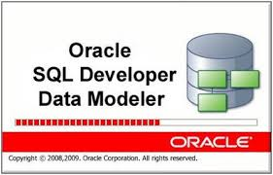
Database Architecture- A Healthcare Project Rohan Purohit Database Architecture
The Business Case:
I would like to model a scenario from healthcare sector. Specifically I would like to design the data dynamics of a local clinic that has physicians issue prescriptions to patients.
The prescriptions can be used to purchase drugs from the pharmacy for the patient. This business is a small business and operates using established healthcare best practices in the Northern Virginia region. There are a dozen doctors and attending staff, four data entry clerks and a dozen administration personnel.
The business also employs a veteran DBA for checking and patching the Oracle 12c database that the clinic uses to keep track of patient details, prescriptions, drugs and pharmacy availability.

Slide 2
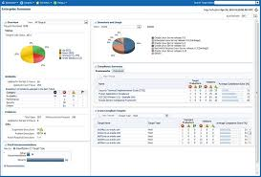
Year end Reporting Functionality
Business Reporting Requirements:
Must generate a report for the patients who were prescribed Albuterol this year.
Must generate a report for patients who were assigned to Psychiatry specialty this year.
Must generate a report for patients who were diagnosed with Schizophrenia and prescribed Clozapine this year.
Must generate a report for drugs that were available in Springfield pharmacy this year.
Must generate a report for drugs that were available in Fairfax pharmacy this year.
Must generate a report for doctors that were assigned to Cardiac specialty this year.

Slide 3
Business Rules, ERD and Normalization
Business Rules:
(0, 1)A DOCTOR writes one or more PRESCRIPTIONS. (1, N)
(1, N)One or more PRESCRIPTIONS may be written by a DOCTOR (0, 1)
(0, 1)A PATIENT may receive one or more PRESCRIPTIONS. (1, N)
(1, N)One or more PRESCRIPTIONS may be received by a PATIENT (0, 1)
(0, 1)A DRUG may appear in one or more PRESCRIPTIONS. (1, N)
(0, 1)A PRESCRIPTION may contain one or more DRUGS (0, N)
(0, 1)A PHARMACY may stock one or more DRUGS. (1, N)
(1, N)One or more DRUGS can be stocked by a PHARMACY (0, 1)

Slide 4
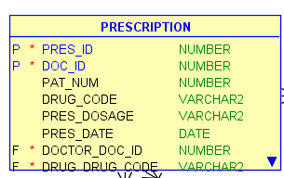
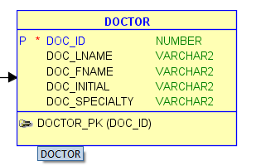
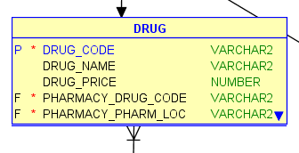
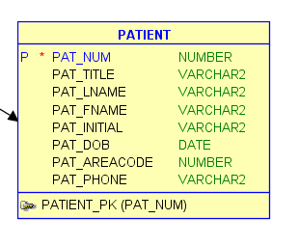
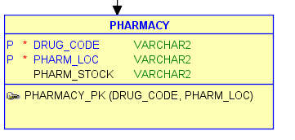
ER Model
DOCTOR writes PRESCRIPTION
DRUG appears in PRESCRIPTION
PATIENT receives PRESCRIPTION
PHARMACY stocks DRUGS

Slide 5

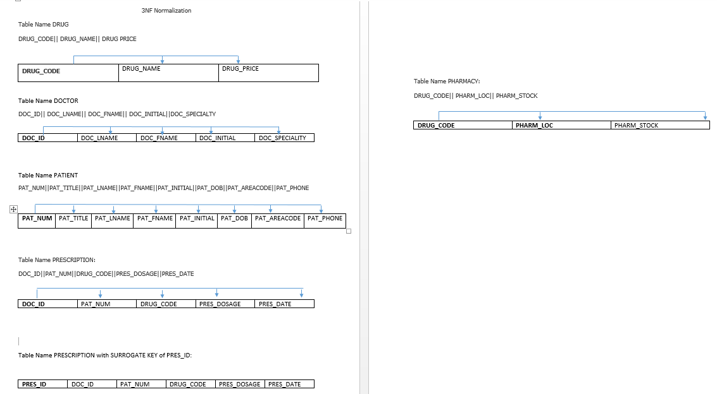
Normalization to the 3NF

Slide 6
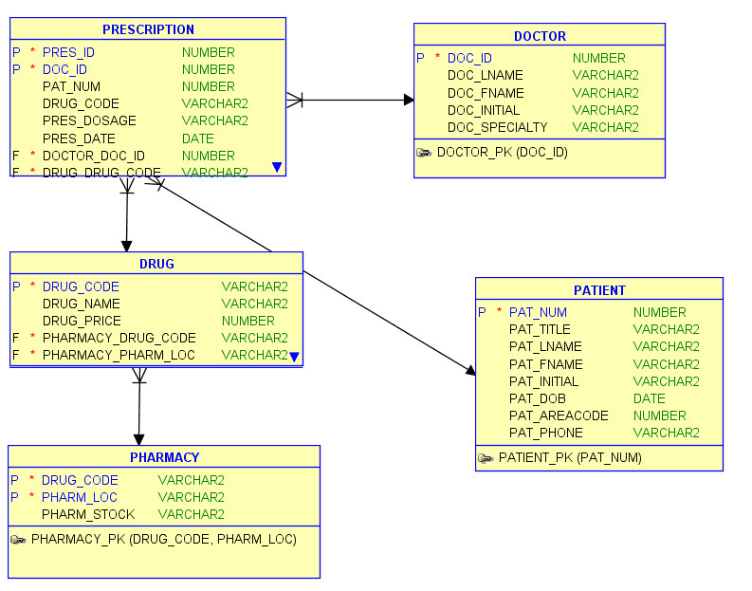
The Data Dictionary View of the System

Slide 7
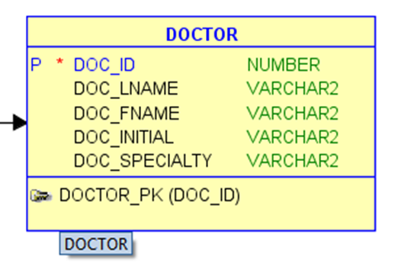

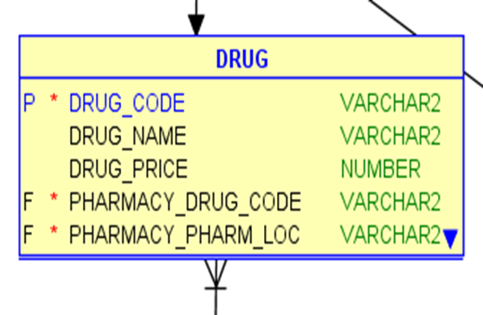
The SQL DDL Generated for the System DDL for DOCTOR and DRUG Tables
CREATE TABLE DOCTOR
(
DOC_ID NUMBER NOT NULL ,
DOC_LNAME VARCHAR2 ,
DOC_FNAME VARCHAR2 ,
DOC_INITIAL VARCHAR2 ,
DOC_SPECIALTY VARCHAR2
) ;
ALTER TABLE DOCTOR ADD CONSTRAINT DOCTOR_PK PRIMARY KEY ( DOC_ID ) ;
CREATE TABLE DRUG
(
DRUG_CODE VARCHAR2 NOT NULL ,
DRUG_NAME VARCHAR2 ,
DRUG_PRICE NUMBER ,
PHARMACY_DRUG_CODE VARCHAR2 NOT NULL ,
PHARMACY_PHARM_LOC VARCHAR2 NOT NULL
) ;
ALTER TABLE DRUG ADD CONSTRAINT DRUG_PK PRIMARY KEY ( DRUG_CODE ) ;

Slide 8
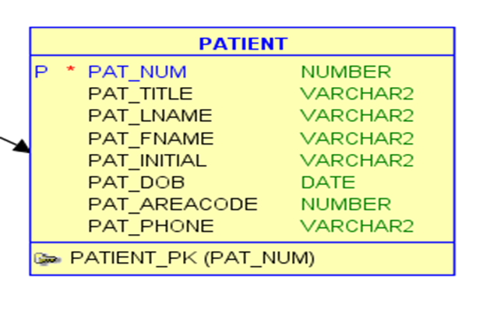

DDL for PATIENT and PHARMACY Tables
CREATE TABLE PATIENT
(
PAT_NUM NUMBER NOT NULL ,
PAT_TITLE VARCHAR2 ,
PAT_LNAME VARCHAR2 ,
PAT_FNAME VARCHAR2 ,
PAT_INITIAL VARCHAR2 ,
PAT_DOB DATE ,
PAT_AREACODE NUMBER ,
PAT_PHONE VARCHAR2
) ;
ALTER TABLE PATIENT ADD CONSTRAINT PATIENT_PK PRIMARY KEY ( PAT_NUM ) ;
CREATE TABLE PHARMACY
(
DRUG_CODE VARCHAR2 NOT NULL ,
PHARM_LOC VARCHAR2 NOT NULL ,
PHARM_STOCK VARCHAR2
) ;
ALTER TABLE PHARMACY ADD CONSTRAINT PHARMACY_PK PRIMARY KEY ( DRUG_CODE, PHARM_LOC ) ;

Slide 9
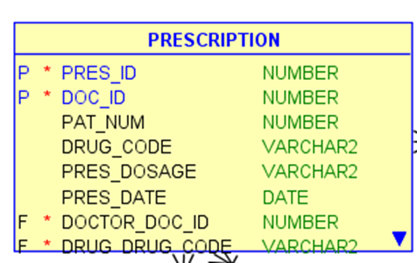
DDL for PRESCRIPTION Table and Foreign Keys and Constraints
CREATE TABLE PRESCRIPTION
(
PRES_ID NUMBER NOT NULL ,
DOC_ID NUMBER NOT NULL ,
PAT_NUM NUMBER ,
DRUG_CODE VARCHAR2 ,
PRES_DOSAGE VARCHAR2 ,
PRES_DATE DATE ,
DOCTOR_DOC_ID NUMBER NOT NULL ,
DRUG_DRUG_CODE VARCHAR2 NOT NULL ,
PATIENT_PAT_NUM NUMBER NOT NULL
) ;
ALTER TABLE PRESCRIPTION ADD CONSTRAINT PRESCRIPTION_PK PRIMARY KEY ( PRES_ID, DOC_ID ) ;
ALTER TABLE DRUG ADD CONSTRAINT DRUG_PHARMACY_FK FOREIGN KEY ( PHARMACY_DRUG_CODE, PHARMACY_PHARM_LOC ) REFERENCES PHARMACY ( DRUG_CODE, PHARM_LOC ) ;
ALTER TABLE PRESCRIPTION ADD CONSTRAINT PRESCRIPTION_DOCTOR_FK FOREIGN KEY ( DOCTOR_DOC_ID ) REFERENCES DOCTOR ( DOC_ID ) ;
ALTER TABLE PRESCRIPTION ADD CONSTRAINT PRESCRIPTION_DRUG_FK FOREIGN KEY ( DRUG_DRUG_CODE ) REFERENCES DRUG ( DRUG_CODE ) ;
ALTER TABLE PRESCRIPTION ADD CONSTRAINT PRESCRIPTION_PATIENT_FK FOREIGN KEY ( PATIENT_PAT_NUM ) REFERENCES PATIENT ( PAT_NUM ) ;

Slide 10
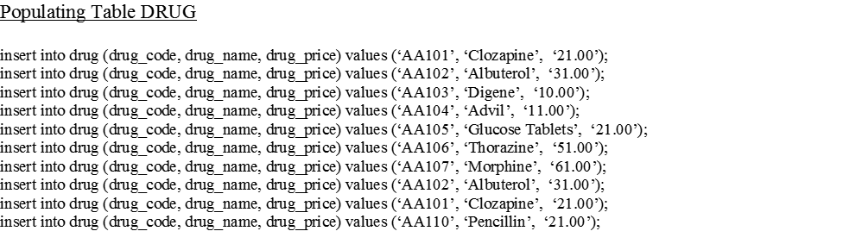
Populating Tables with Sample Data

Slide 11
Populating Table PRESCRIPTION and PATIENT

Slide 12
Populating Table PHARMACY

Slide 13
Reporting Solution
Must generate a report for the patients who were prescribed Albuterol this year.
Answer:
Select * from prescription where drug_code = ‘AA102’;
Must generate a report for patients who were assigned to Psychiatry specialty this year.
Answer:
Select * from prescription where doc_id = ‘100’ or ‘105’ or ‘107’;
Must generate a report for patients who were diagnosed with Schizophrenia and prescribed Clozapine this year.
Answer:
Select * from prescription where drug_code = ‘AA101’;
Must generate a report for drugs that were available in Springfield pharmacy this year.
Answer:
Select * from pharmacy where pharm_loc = ‘Springfield, Virginia’ AND pharm_stock = ‘Yes, in stock’;
Must generate a report for drugs that were available in Fairfax pharmacy this year.
Answer:
Select * from pharmacy where pharm_loc = ‘Fairfax, Virginia’ AND pharm_stock = ‘Yes, in stock’;
Must generate a report for doctors that were assigned to Cardiac specialty this year.
Answer:
Select * from doctor where doc_specialty = ‘Cardiology’;

Slide 14
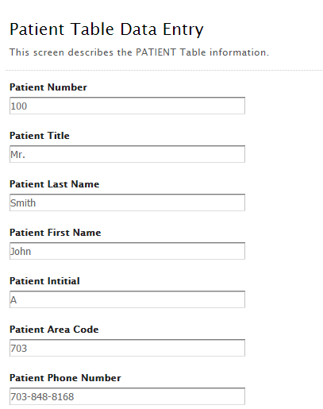

User Interface Documentation
As the patient visits the clinic the clinic receptionist and data entry clerk hand out the following form to the patient to capture the necessary patient details. These details are the patient name, area code and phone number. Each patient is then assigned a patient number and given the associated ticket.

Slide 15
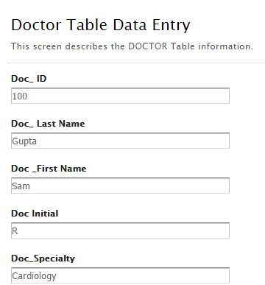

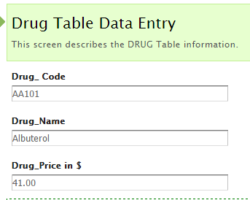

Each patient is then assigned to a particular doctor. Each doctor has a doc_id and a specialty that he or she is noted for.
After the doctors consultation a doctor may write one or more prescriptions which may contain one or more drugs. In the backend each drug prescribed is logged in the DRUG database table with its associated drug_code and drug_name and the associated cost of the drug per unit.

Slide 16
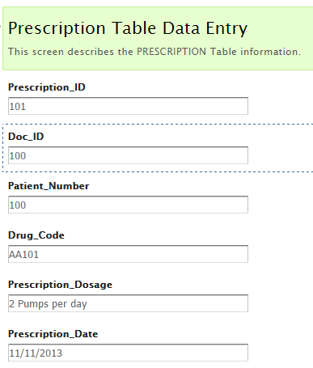

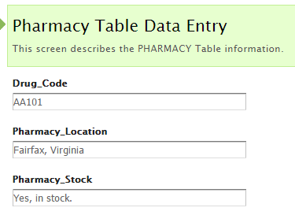

A doctor may write one or more prescriptions which may contain one or more drugs. Each prescription is documented in the prescription table with a prescription_id and date its associated doctor id, patient number, drug code prescribed and recommended prescription dosage suggested by the doctor.
The clinic keeps track of nearby pharmacies that stock the prescribed drugs. Each drug is indexed by drug code and matched to a pharmacy in Fairfax, McLean or Springfield locations in Virginia. Each drug is described as being in or out of stock.

